Slide 1
CAPSTONE PROJECT PRESENTATION
卒業論文プレゼンテーション

Slide 2
BOOKAHOLIC SOCIAL NETWORK
Meet the team
Bookaholic Social Network
1. Introduction- 導入
Fusce som libero topi sombrero bikinan meksiko when an unknown printer took a galley of type and scrambled.

Slide 3
2. Project Management - プロジェクト管理
.

3. Software Requirement Specifition
- ソフトウェア要求仕様
4. Software Design Description - ソフトウェア設計説明書.
5. Quality Control
- 品質管理

Slide 4
6. Project Result - プロジェクト結果

7. Demo- デモ
8. Q&A - 質問と回答
End
4

Slide 5
MEET THE TEAM

Slide 6
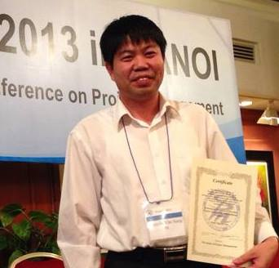




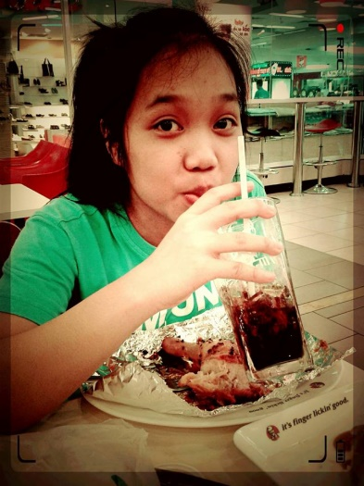

Meet the Team
NGUYEN VAN SANG
PHAM THI HUYEN
Instructor
Project Manager, Developer
VU HAI ĐANG
NGUYEN THI HAI YEN
Technical Leader, Developer
Designer, Test Leader, QA
THAI THI CAM VAN
CHU MINH HAI
Designer Leader, Developer
Designer, Tester

Slide 7

I. Introduction
1. Current Situation - 現在状況
2. The Idea - アイデア

Slide 8






1. Current Situation - 現在状況
Nowadays, there are so many social networks such as Facebook, Zalo, etc. But there is not many social network for book lovers who enjoy to reading books, especially for Vietnamese.
8

Slide 9



2. The Idea - アイデア
Build a book social network that allows:
Book lovers and authors join together
Sharing, recommending, reviewing great books for everyone
9

Slide 10
PROJECT MANAGEMENT

Slide 11
PROJECT MANAGEMENT
Software Process Model
ソフトウェアプロセスモデル
Project Organization
プロジェクト組織
Project Schedule
プロジェクト計画
Objectives & deliverables
目標と成果物
Tools & Infrastructure
ツールと インフラストラクチャ
Risks management
リスク管理
Configuration management
コンフィグレーション管理
コミュニケーション管理
Communication management

Slide 12
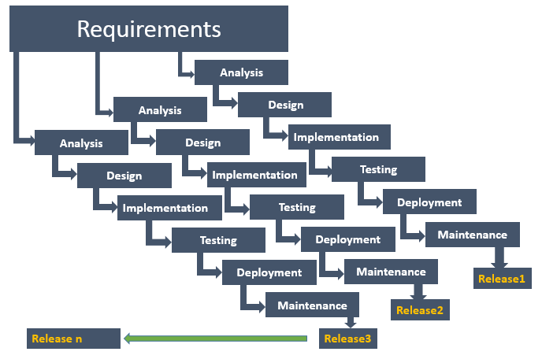
1. Software Process Model - ソフトウェアプロセスモデル

Slide 13
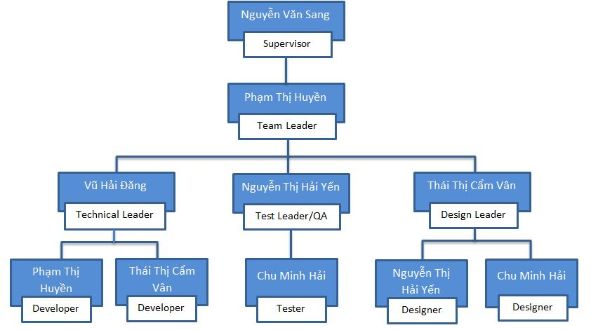
2. Project Organization -プロジェクト組織

Slide 14
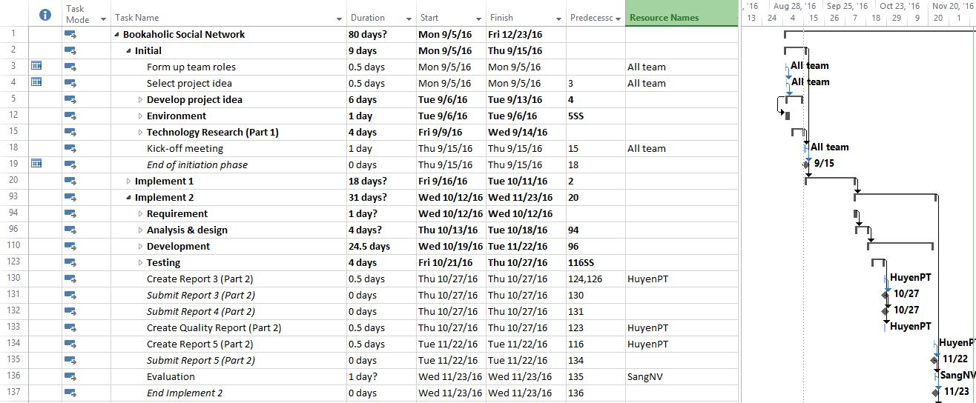
3. Project Schedule - プロジェクト計画
14

Slide 15
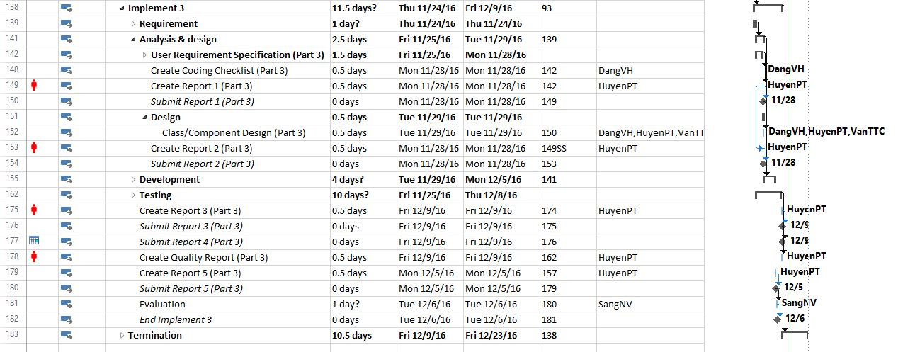
3. Project Schedule - プロジェクト計画
15

Slide 16
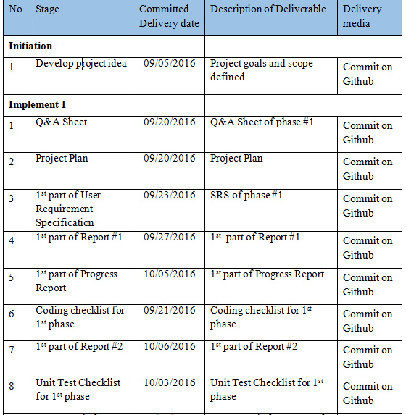
4. Objectives & deliverables -目標と成果物
16

Slide 17
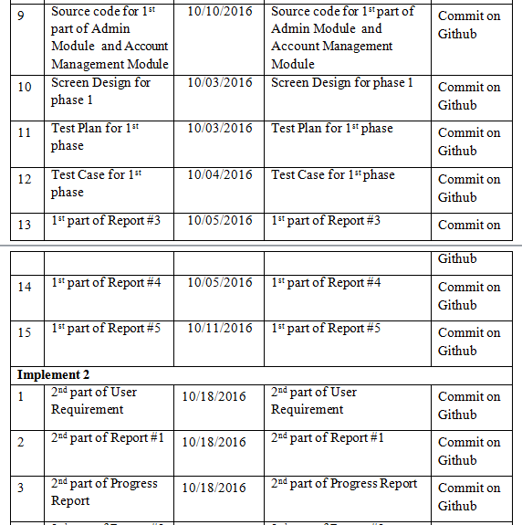
4. Objectives & deliverables -目標と成果物
17

Slide 18
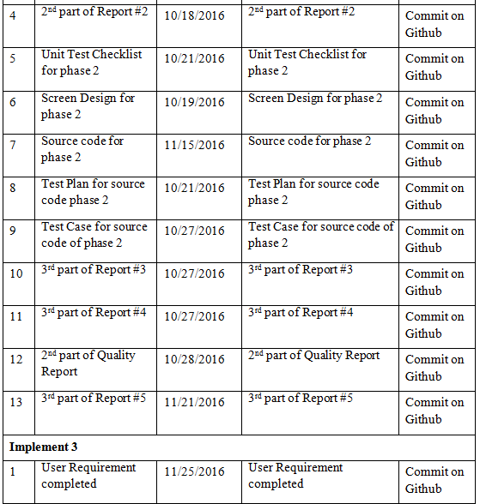
4. Objectives & deliverables -目標と成果物
18

Slide 19
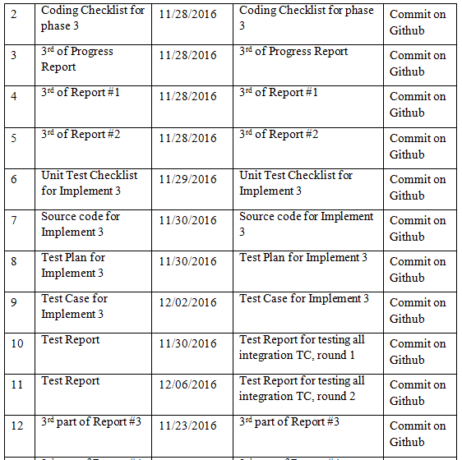
4. Objectives & deliverables -目標と成果物
19

Slide 20
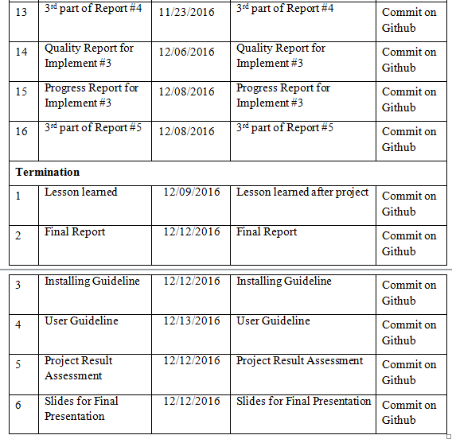
4. Objectives & deliverables -目標と成果物
20

Slide 21












5. Tools & Infrastructure - ツールと インフラストラクチャ
TOOLS
Tools for project management
Tools for developing
Microsoft Project
GitHub
Visual Studio
Google Chrome
Robo mongo
Tools for document
Tools for design
Microsoft PowerPoint
Microsoft Word
Microsoft Excel
Microsoft Visio
Astah
Photoshop
Brackets
< >
21

Slide 22
6. Risks management -リスク管理
No | Risk | Root Cause | Triggers | Avoidance plan | Contingency plan | Fallback plan
1 | Conflict among team members | Team member doesn't understand each others | Has issue inside team | Plan some team buildings to improve teammate | Have a meeting to resolve conflict problem | Switch member to other team.
2 | Requirement is changed after project is started | SRS not good (not realistic, not feasibility, not meet customer needs) | Customer (user) make change request. Or project team cannot develop the system as description in SRS. | Requirement should be paid a lot of attention. SRS should be reviewed carefully by PM and the supervisor. | With each requirement changes, the project team should have a meeting to analysis the change requests and take actions. | Re-estimate and update plan.
3 | Team member do not meet the deadline | Undisciplined and habit of team member, loose management | Have a deadline | Setting rule and minus of do not meet the deadline: punish money and named at meeting minute. | Punish the member do not meet the deadline. Working over time. | Ask for help from out of team, supervisors.
4 | Delivery project doesn’t meet requirement | Team member not understand requirement | Can't delivery project | Team lead have to review source code and follow requirement | Fix in next version | Extend deadline
リスク管理 - Risks management
22

Slide 23
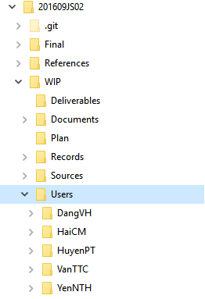
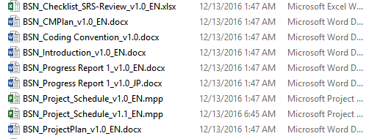
7. Configuration management - コンフィグレーション管理
Folder structure of project
Naming conventions
23

Slide 24












8. Communication management - コミュニケーション管理
Time:
Communication
8 hours/day
5 days/week
Location
Project Meeting
24

Slide 25
Software Requirements Specification

Slide 26
1. System Users - システムのユーザ
2. Functional Requirements - 機能要求
3. Non-Functional Requirements - 非機能要求
26

Slide 27


1. System Users - システムのユーザ
Guest
Reader/Author
Administrator
27

Slide 28
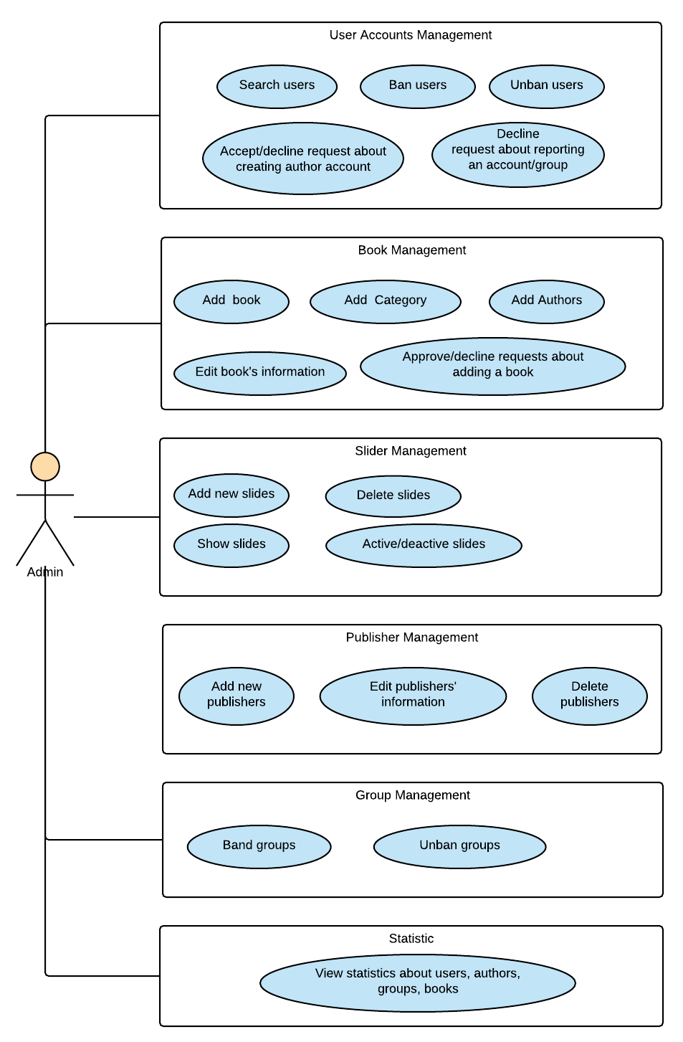
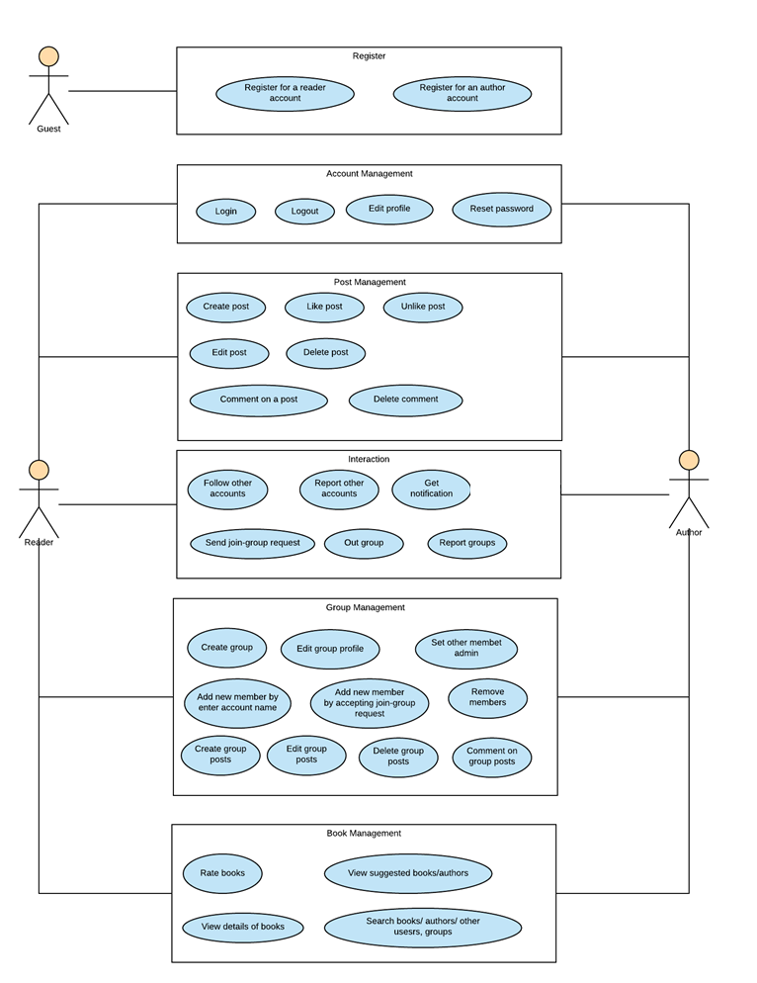
2. Functional Requirements - 機能要求
ユースケース図 – User case diagram
28

Slide 29
3. Non-Functional Requirements - 非機能要求
Availability
Response time
Maintainability
Usability
Security Requirements
Hardware/Software Requirements
29

Slide 30
Software Design Description

Slide 31
1. Technology & Reason - テクノロジーと理由
2. Architecture Representation - アーキテクチャ表現
3. Database Design - データベース設計
4. Detail Design - 詳細設計
31

Slide 32




1. Technology & Reason - テクノロジーと理由
Core Technology
ASP.NET MVC 5
MongoDB
Sub Technology
Bootstrap
SignalR
32

Slide 33
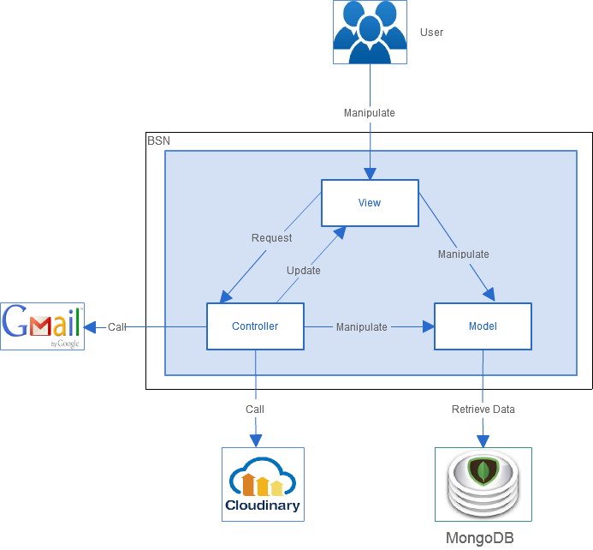
2. Architecture Representation - アーキテクチャ表現
33

Slide 34
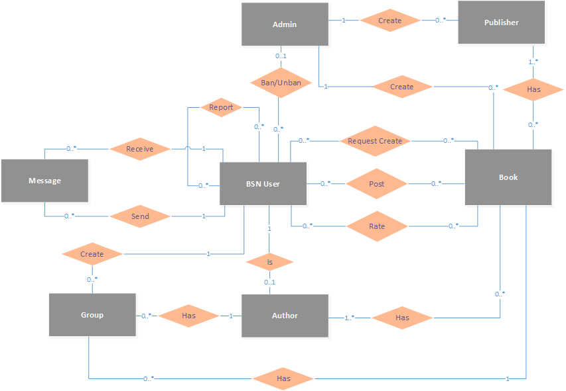
3. Database Design - データベース設計
エンティティ関係図
Entity Relationship Diagram
34

Slide 35
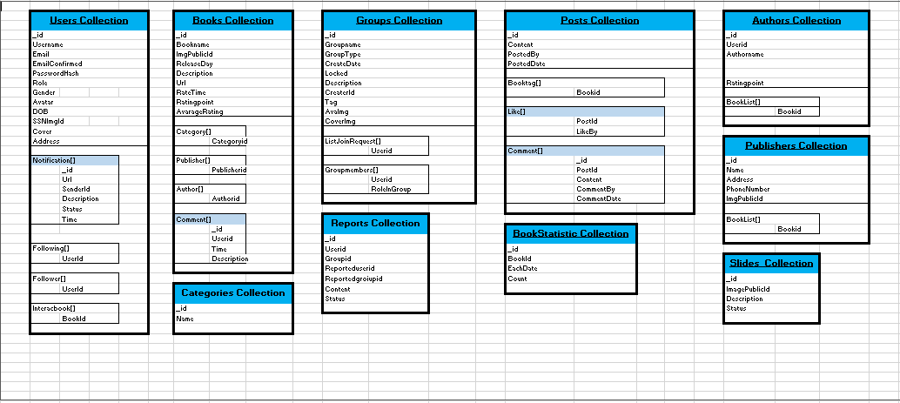
3. Database Design - データベース設計
MongoDBのデータベース設計
MongoDB Database Design
35

Slide 36
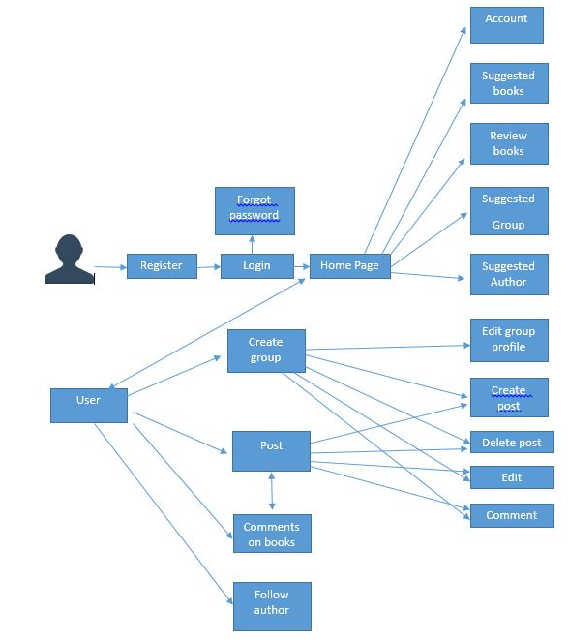
4. Detail Design - 詳細設計
BSNの画面の流れ
BSN Screen Flow
36

Slide 37
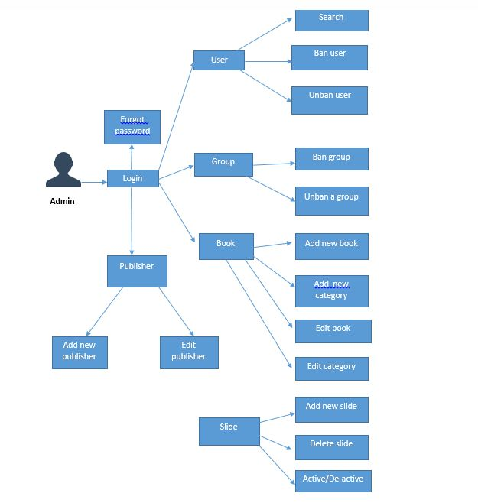
4. Detail Design - 詳細設計
BSNの画面の流れ
BSN Screen Flow
37

Slide 38
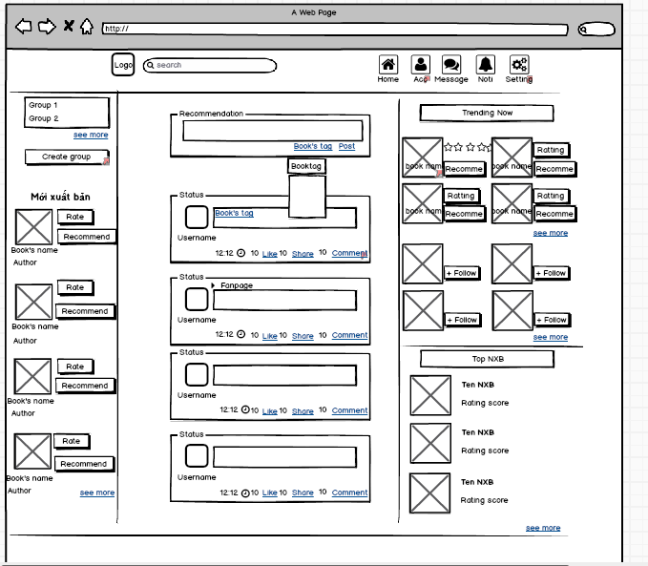
4. Detail Design - 詳細設計
Screen Design - 画面設計
ホームページの画面設計HTML – Homepage Screen Design by HTML
38

Slide 39
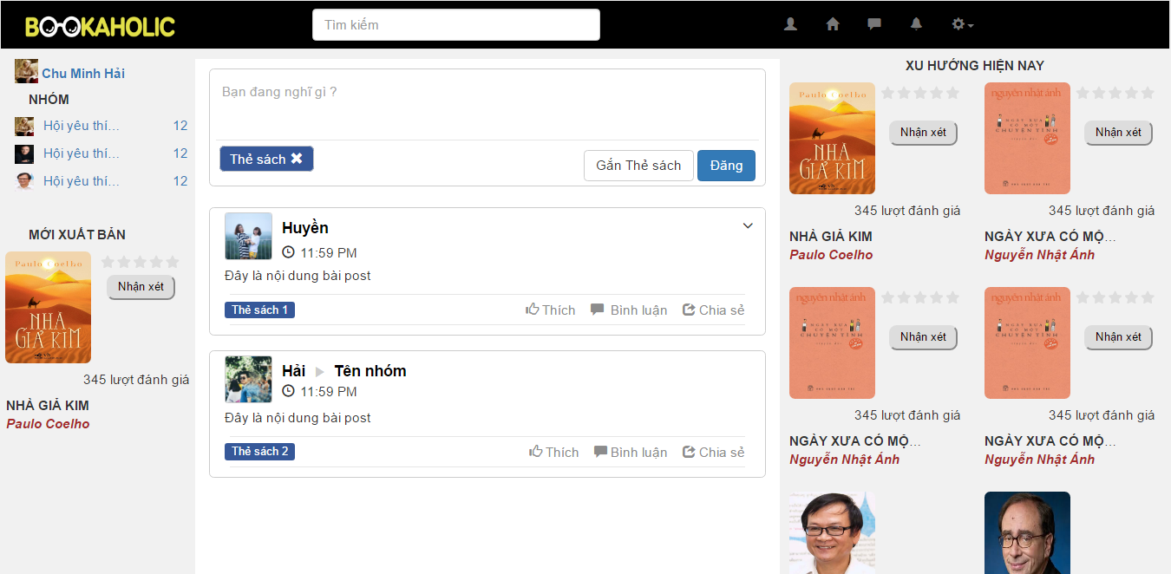
4. Detail Design - 詳細設計
Screen Design - 画面設計
ホームページの画面設計 – Homepage Screen Design
39

Slide 40
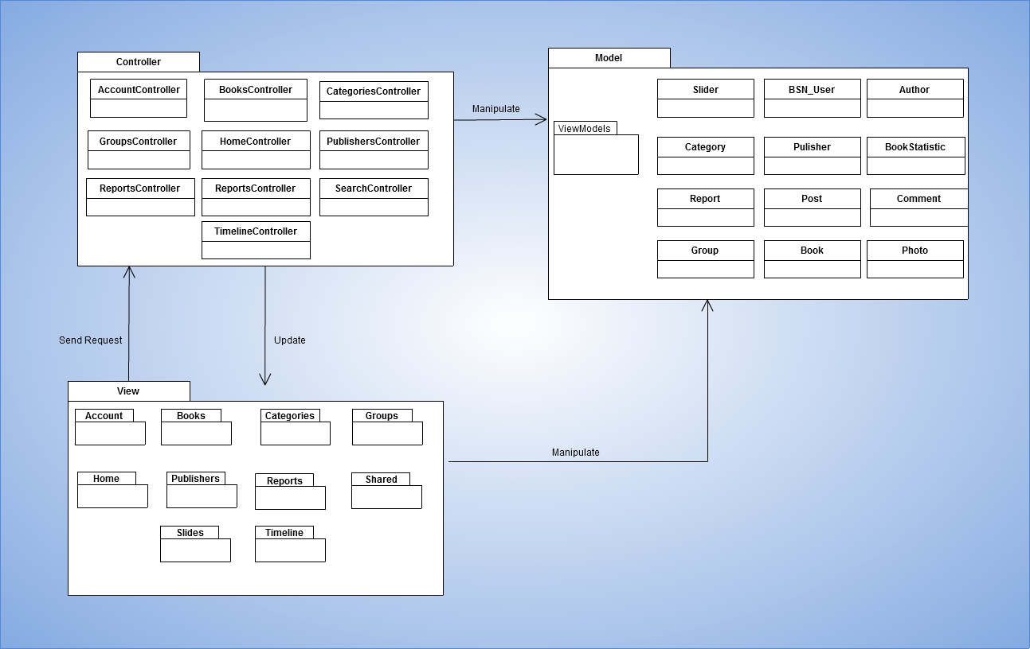
4. Detail Design - 詳細設計
Package View - パッケージ ビュー
パッケージ ビュー
Package View
40

Slide 41
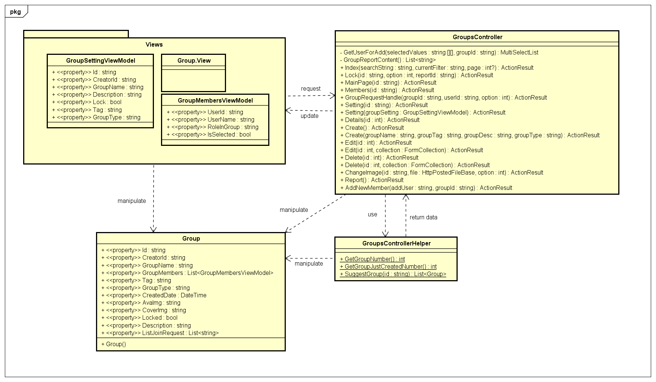
4. Detail Design - 詳細設計
Class Design - クラス設計
41

Slide 42
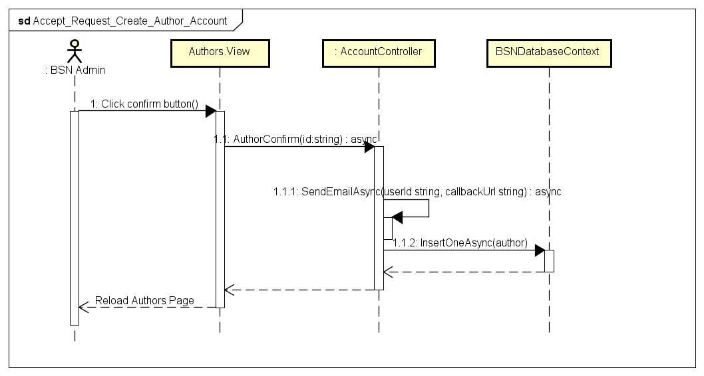
4. Detail Design - 詳細設計
Sequence Diagram
- シーケンス図
42

Slide 43
Quality Control

Slide 44
1. Review
レビュー
2. Testing
テスティング
1.1. Project Plan - プロジェクト計画
2.1. Test Process - テストプロセス
1.2. SRS - 要求仕様
2.2. Test Report - テストレポート
1.3. Design - 設計
1.3. Code - コーディング
1.4. Test Document - テスト
< >
35

Slide 45
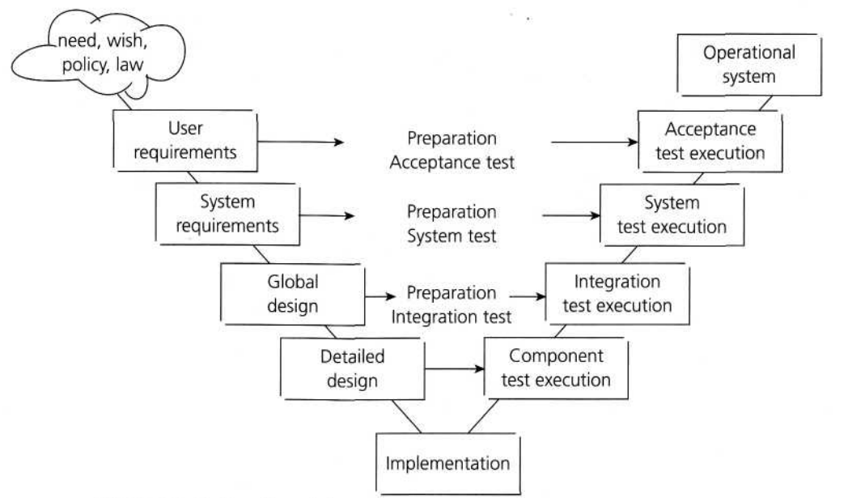
1. Review - レビュー
V-model process
45

Slide 46



1. Review - レビュー
自己評価
Self-review
ピアレビュー
Peer review
グループのレビュー
Group review
46

Slide 47
2. Testing - テスティング
Create Test Plan
Base on Project Plan, Project Schedule , SRS to create test plan:
Features to be tested
Testing Criteria
Environment
Schedules
Responsibilities
Risks and contingencies
47

Slide 48
2. Testing - テスティング
Create Test Plan
Testing criteria:
Statement coverage: 100%
Branch coverage: 100%
Path coverage: 100%
Test Approach:
Unit Test: Developer
Integration Test: Tester
System Test: Tester
Acceptance Test: Supervisor
Test Environment:
Web :Chrome 55.0
48

Slide 49
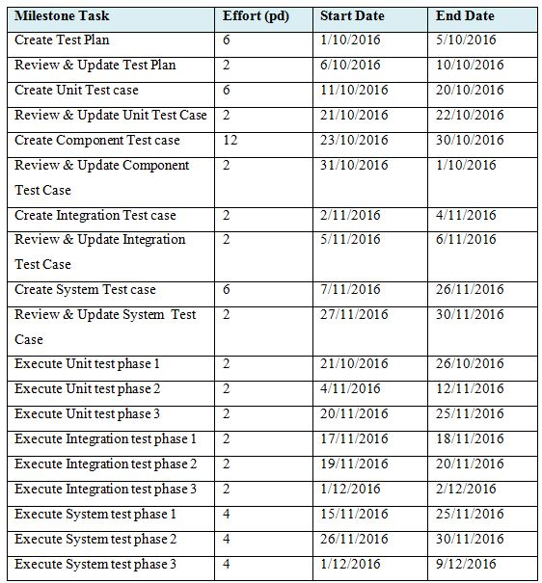
2. Testing - テスティング
Create Test Plan
49

Slide 50
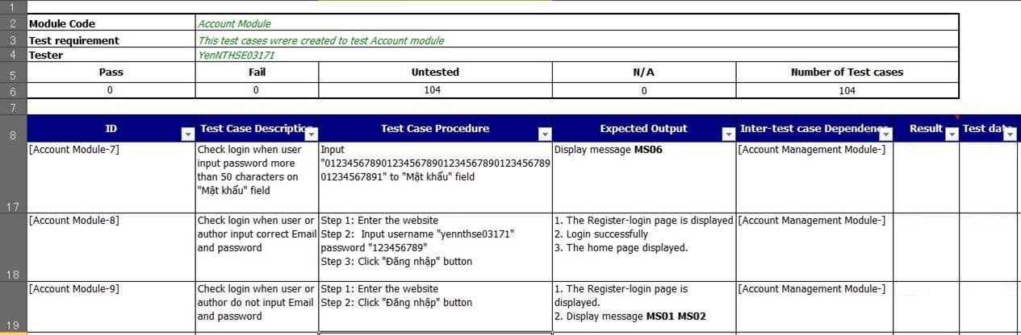
2. Testing - テスティング
Create Test Plan
Create Test Case
Base on SRS, create test case:
Unit test case
Integration test case
System test case
50

Slide 51
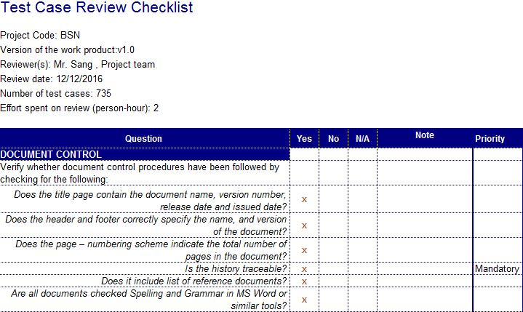
2. Testing - テスティング
Create Test Plan
Create Test Case
Review Test Case
Developer self-review:
Unit test case
Tester self-review and peer-review:
Integration test case
System test case
Test case review checklist -テストレビュー
51

Slide 52
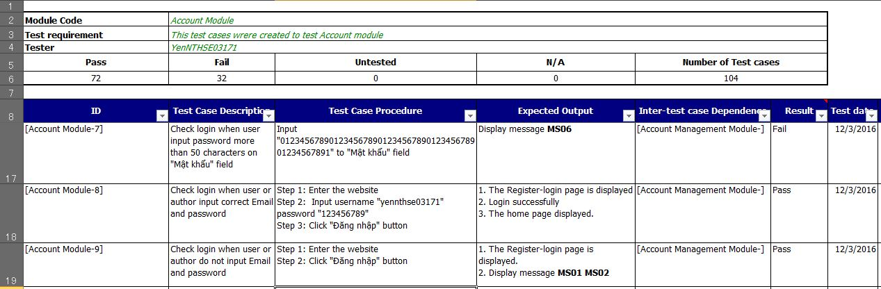
2. Testing - テスティング
Create Test Plan
Create Test Case
Review Test Case
Execute Test
Tester execute test case follow phase:
Unit testing
Integration testing
System testing
Execute test case -テストケースの実行
52

Slide 53
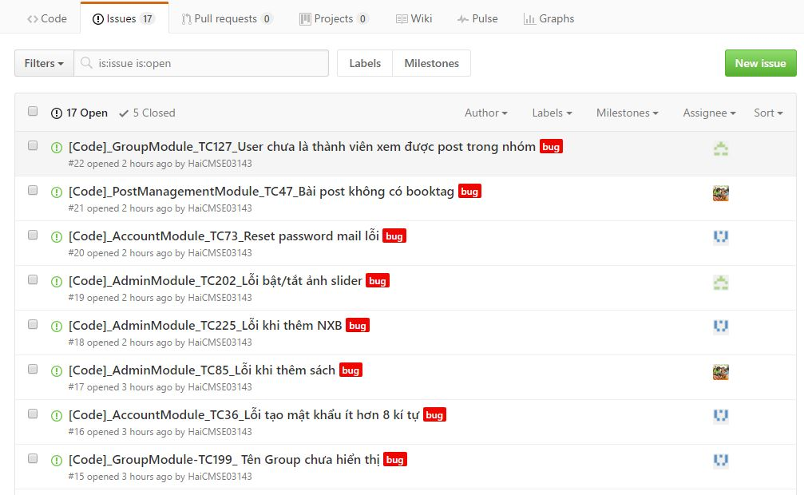
2. Testing - テスティング
Create Test Plan
Create Test Case
Review Test Case
Execute Test
Log Bug
While executing test, tester detect, log bug and assign to appropriate developer.
53

Slide 54
2. Testing - テスティング
Create Test Plan
Create Test Case
Review Test Case
Execute Test
Log Bug
Re-test
When Developer fixed bug, Tester re-test until bug was fixed successfully, then change defect of status to Closed.
Execute test case -テストケースの実行
54

Slide 55
2. Testing - テスティング
Create Test Case
Review Test Case
Execute Test
Log Bug
Re-test
Create Test Report
When Developer fixed bug, Tester re-test until bug was fixed successfully, then change defect of status to Closed.
Defects | Logged | %Closed | %Invalid | %Open
Critical | 0 | 0% | 0% | 0%
High | 5 | 0% | 0% | 0%
Medium | 26 | 100% | 0% | 0%
Low | 34 | 100% | 0% | 0%
Total | 65 | 100% | 0% | 0%
55

Slide 56
2. Testing - テスティング
Create Test Case
Review Test Case
Execute Test
Log Bug
Re-test
Create Test Report
No | Module Code | Round 1 |  | Round 2 |  | Final
 |  | Pass | Fail | Pass | Fail
1 | Unit Test | N/A | N/A | N/A | N/A | N/A
2 | Integration Test | 45 | 5 | 5 | 0 | 50
3 | System Test | 650 | 85 | 85 | 0 | 735
 | Total | 695 | 90 | 90 | 0 | 785
56

Slide 57
Project Result

Slide 58
1. Result - 結果
 | Plan | Actual
Start Date | 09/05/2016 | 09/05/2016
End Date | 14/12/2016 | 14/12/2016
Releases version | 1.0 | 1.0
Duration | 78 | 78
Effort (person-day) | 390 | 390
Test cases | 1000 | 1524
Defects | 70 | 65
Document pages | ~ 1500 pages | ~ 1400 pages
Lines of code (C#) | ~ 7000 | ~ 6000
Lines of code (HTML) | ~ 6500 | ~6200
Lines of code ( javascript: jquery and knockout js ) | ~700 | ~800
LOC (Total) | ~ 14200 | ~ 13000
58

Slide 59
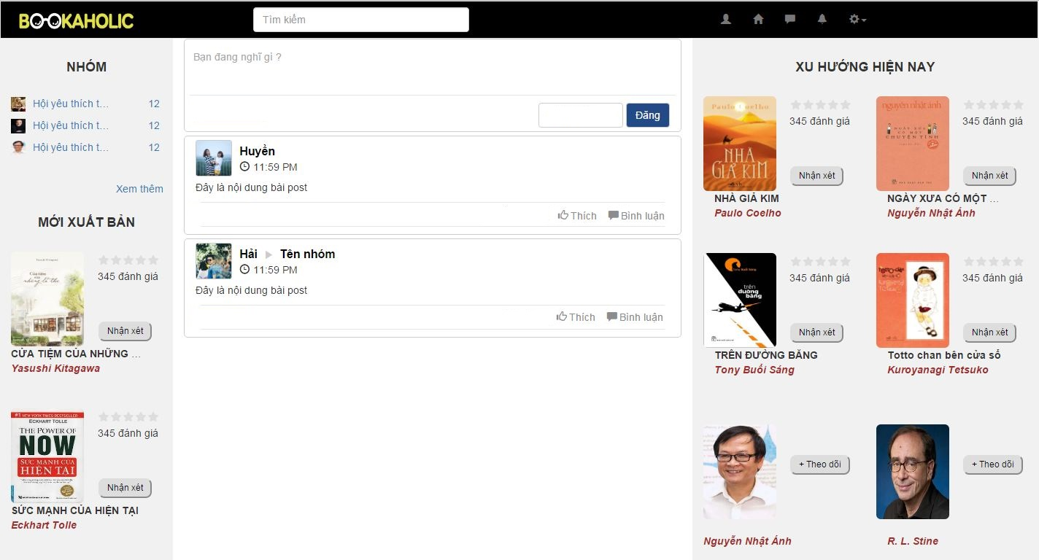
1. Result - 結果
59

Slide 60
2. Limitation & Expectation - 制限と期待
Current Limitations
Expectation in Future
Website does not support Multilanguage
Support Multilanguage
Some screen cannot display well
Support view in Mobile and Tablet
Does not provide account registration by Gmail or Facebook account
Support more interact functions
60

Slide 61
3. Lessons Learnt - 学んだ教訓
Working in group and working individual.
Putting knowledge into practice.
Manage time and make the plan.
Be open to get the better opinions from other member.
Limit and resolve conflicts between members.
61

Slide 62
DEMO & QA

Slide 63
THANKS FOR LISTENING
BOOKAHOLIC
SOCIAL NETWORK

